Slide 1
DATA SCIENCE UNIT II ANOVA From: Web resources

Slide 2
Contents
Introduction
Types of ANOVA
ANOVA Procedure
One way ANOVA
Two way ANOVA
Application

Slide 3
Introduction
ANOVA is a statistical test for estimating how a quantitative dependent variable changes according to the levels of one or more categorical independent variables.
ANOVA tests whether there is a difference in means of the groups at each level of the independent variable.
Analysis of variance (abbreviated as ANOVA)
An extremely useful technique concerning researches in the many fields of economics, biology, education, psychology, sociology, business/industry and in researches of several other disciplines.
This technique is used when multiple sample cases are involved.
The ANOVA technique enables us to perform to examine the significance of the difference amongst more than two sample means at the same time.
Using this technique, one can draw inferences about whether the samples have been drawn from populations having the same mean.

Slide 4
What is ANOVA ?
Variance is an important statistical measure and is described as the mean of the squares of deviations taken from the mean of the given series of data. It is a frequently used measure of variation. square of standard deviation is called variance.
i.e., Variance = (standard deviation)² .
There may be variation between samples and also within sample items.
In other words, ANOVA help us to figure out if there is need to reject the null hypothesis or accept the alternate hypothesis

Slide 5
ANOVA Examples:
A group of psychiatric patients are trying three different therapies: counseling, medication and biofeedback. We want to see if one therapy is better than the others.
A manufacturer has two different processes to make light bulbs. They want to know if one process is better than the other.
Students from different colleges take the same exam. You want to see if one college outperforms the other.

Slide 6
Types of ANOVA
ANOVA is two types
One way ANOVA :
only one factor is investigate
one independent variable (with 2 levels)
Analysis of Variance could have one independent variable
Two Way ANOVA :
investigate two factors at the same time.
two independent variables (can have multiple levels).
Analysis of Variance has two independent variables.
Two way ANOVA without replication
Two way ANOVA with replication

Slide 7
Principle of ANOVA
We have to make two estimates of population variance viz., one based on between samples variance and the other based on within samples variance. Then the said two estimates of population variance are compared with F-test, wherein we work out.
F = Estimate of population variance based on between samples variance
Estimate of population variance based on within samples variance
This value of F is to be compared to the F-limit for given degrees of freedom. If the F value we work out is equal or exceeds the F-limit value.
We may say that there are significant differences between the sample means.

Slide 8
ANOVA procedure
The Seven Steps are Step 1: Calculate the Mean Step 2: Setup the null and alternate hypothesis Step 3: Calculate the Sum of Squares Step 4: Calculate the Degrees of Freedom Step 5: Calculate the Mean Squares Step 6: Calculate the F Statistic Step 7: Look up statistical Table and state your conclusion

Slide 9
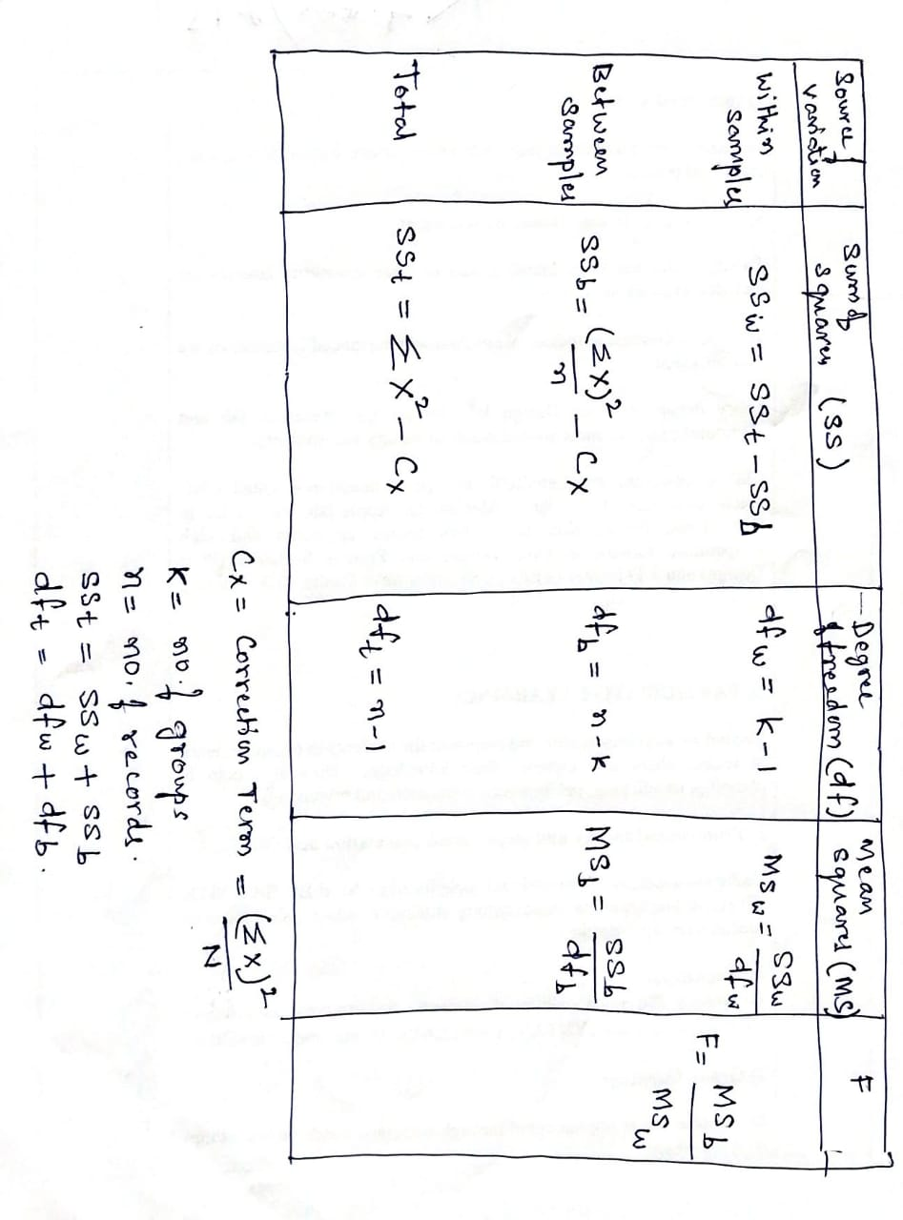

One-way ANOVA formula

Slide 10
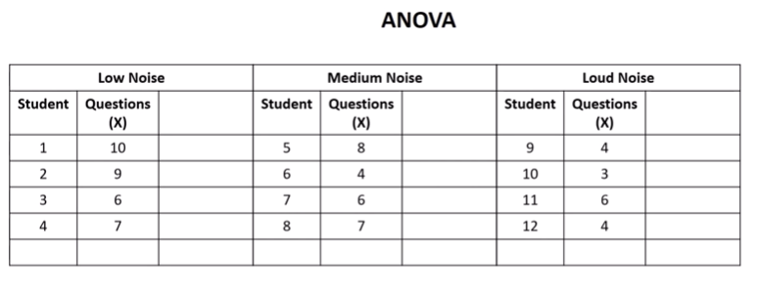
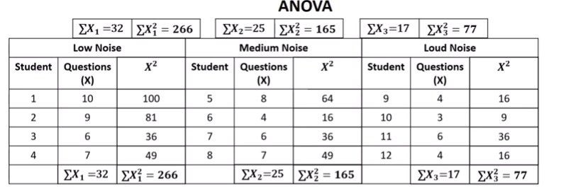
Example 1: Data related to no. of questions solved in different types of noises. Find the significance of the noise on solving questions
k: No of groups=3
n: No. records= 12
Null hypothesis Ho:
There is no significance of noise in writing questions

Slide 11
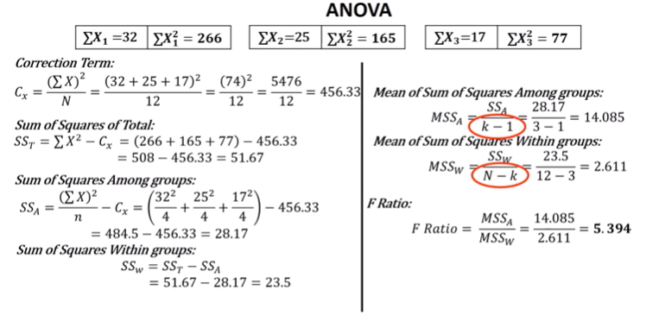
Example

Slide 12
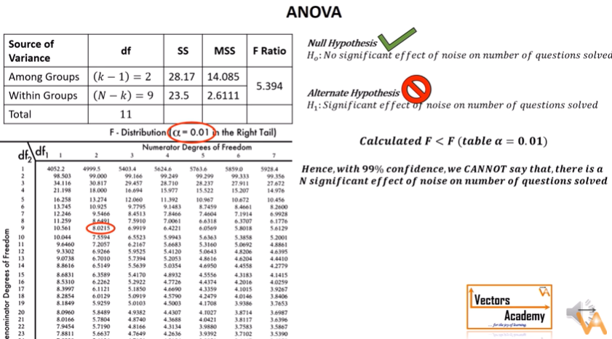
Example

Slide 13
Example -2
Set up an analysis of variance table for the following per acre production data for three varieties of wheat, each grown on 4 plots and state if the variety differences are significance.
Plots of land | per acre production data
 | variety of wheat
 | A | B | C
1 | 6 | 5 | 5
2 | 7 | 5 | 4
3 | 3 | 3 | 3
4 | 8 | 7 | 4

Slide 14
Table :
Example 2 Answers
one way anova
d.f. MS
5% F-
limit(from the f ratio table)
Source of SS variation
f- ratio
Between 8 sample
(3-1)= 2
8/2 = 4
4/2.67=
1.5
F(2,9)= 4.26
Within
Sample
24
(12-3) = 9
24/9 =
2.67
Total
32
(12-1) =
11

Slide 15
Conclusion
The above table shows that the calculated value of F is 1.5 which is less than the table value of 4.26 at 5% level with
d.f. being v1 = 2 and v2 = 9 and hence could have arisen due to chance.
This analysis supports the null-hypothesis of no difference is sample means.
The difference in wheat output due to varieties is insignificant and is just a matter of chance.
It means that the varieties is not so much differ from each other

Slide 16
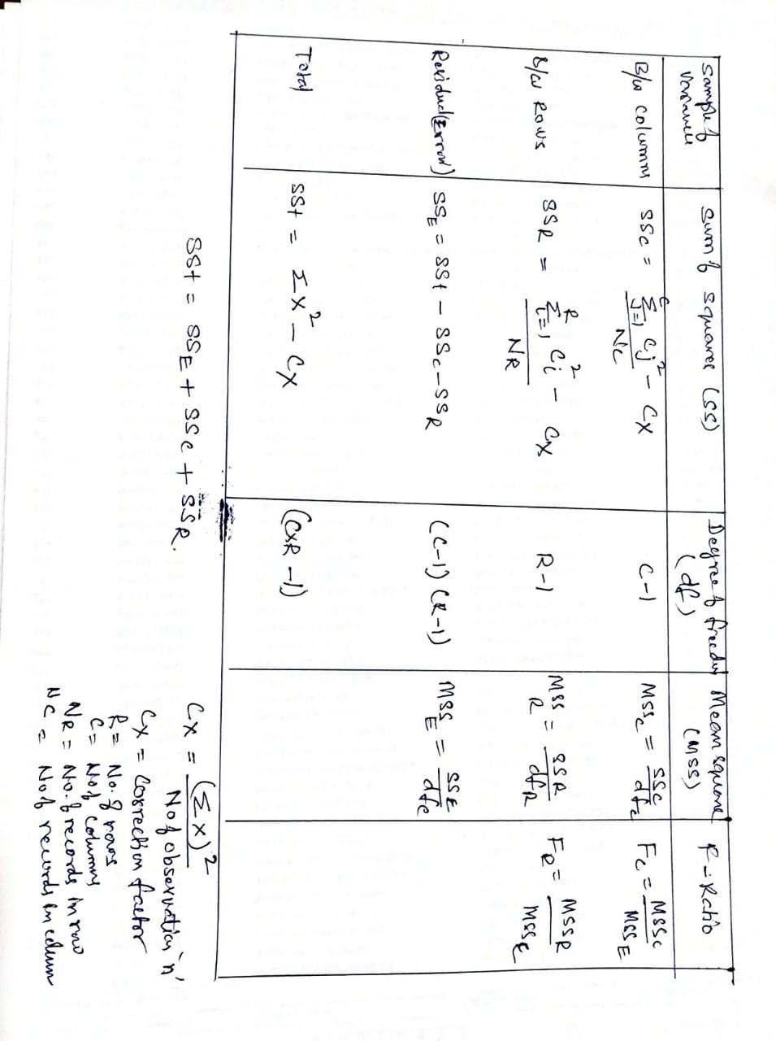
Two-way ANOVA- without replication formula

Slide 17
Example -1 Set up an analysis of variance table for the following two- way design results:
Two-way ANOVA- without replication : Example
 | per acre production data
 | Varieties of seeds
Varieties of fertilizers | A | B | C
W | 6 | 5 | 5
X | 7 | 5 | 4
Y | 3 | 3 | 3
Z | 8 | 7 | 4

Slide 18
Step1 : Obtain the total value of individual
Total = sum of all individual
= 6+7+3+8+5+5+3+7+5+4+3+4
=60
so we have T= 60 and n = 12
Where
T = sum of all individual sample
N = number of sample
Step 2 : calculate correction factor
Correction factor = Square of total value / number of sample So correction factor Cx= (T)² /n
= 60*60/12 = 300

Slide 19
Step 2 : calculate Total SS
Total SS = square of all the items value – correction factor
= {(36+25+25+49+25+16+9+9+9+64+49+16) – (60*60/12)}
= 332-300
= 32
Individual value | squaring | Result of squaring
6 | 6*6 | 36
5 | 5*5 | 25
5 | 5*5 | 25
7 | 7*7 | 49
5 | 5*5 | 25
4 | 4*4 | 16
3 | 3*3 | 9
3 | 3*3 | 9
3 | 3*3 | 9
8 | 8*8 | 64
7 | 7*7 | 49
4 | 4*4 | 16
So we have total SS = 32

Slide 20
Step 3 : calculate SS between columns treatment
SS between column = sum of all (sqaure of individual column / sample in column)
– correction factor
= (24*24/4 + 20*20/4+16*16/4 ) – (60*60/12)
= 144 +100+60 – 300
=8
24*24 | 576/4 = 144
20*20 | 400/4= 100
16*16 | 256/4=60

Slide 21
Step 4 : calulate SS Between rows treatment
SS between = sum of all square of individual row / number of sample)
– correction factor
= (16*16/3 + 16*16/3 +9*9/3)
–(60*60/12)
= 85.33 + 85.33 +27+120.33 – 300
= 317.99 - 300
=18
16*16 | 256/3=85 .33
16*16 | 256/3=85 .33
9*9 | 81/3=27
19*19 | 361/3 = 120.33

Slide 22
Step 5 : SS residual or error
SS residual = Total SS – (SS between columns + SS between rows)
=32 - (8+18)
= 6
Step 6 : find degree of freedom
d.f. for variance between columns = (c – 1) = 3-1 = 2
d.f. for variance between rows = (r – 1) = 4-1 = 3
d.f. for residual variance = (c – 1) (r – 1) = 2*3 = 6
d.f. for total variance = (c . r – 1) = 3*4 – 1 = 12 - 1 = 11

Slide 23
we have some important quantitative value
Finally
SS between column | 8
SS between row | 18
SS residual | 6
d.f for variation between column | 2
d.f for variation between row | 3
d.f for residual variance | 6
d.f for total variance | 11

Slide 24
Conclusion
The above table shows that the calculated value of F is 4 which is less than the table value 5.14 of at 5% level with
d.f. being v1 = 2 and v2 = 6 in column .
a) This analysis show has no significance .
The f value in rows
is 6 which is higher than the table 4.76 of a 5% level with
d.f. Being v1=3 and v2= 6.
b)This analysis supports the null-hypothesis which shows difference is sample means.

Slide 25
It means that differences concerning varieties of seeds are insignificant at 5% level as the calculated F- ratio of 4 is less than the table value of 5.14 but the variety differences concerning fertilizers are significant as the calculated F ratio of 6 is more than its table value of 4.76
Fertilizers act differently, the different varieties of seeds are affected differently.

Slide 26
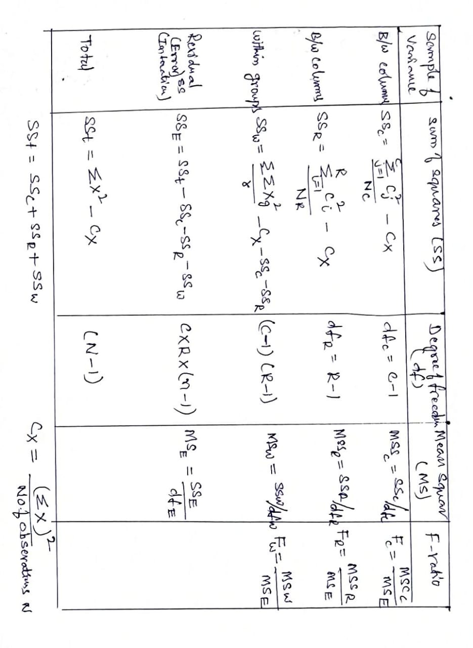
Two-way ANOVA- with replication formula

Slide 27
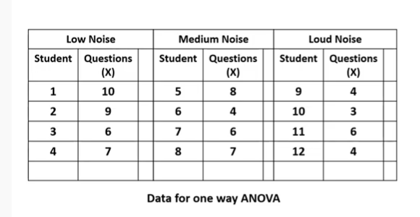
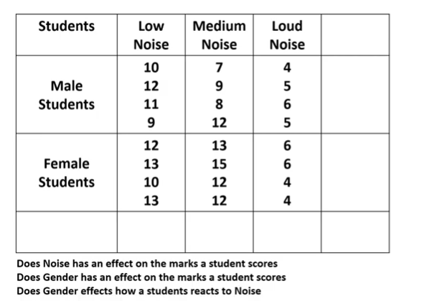
Two-way ANOVA with replication: Example 1

Slide 28
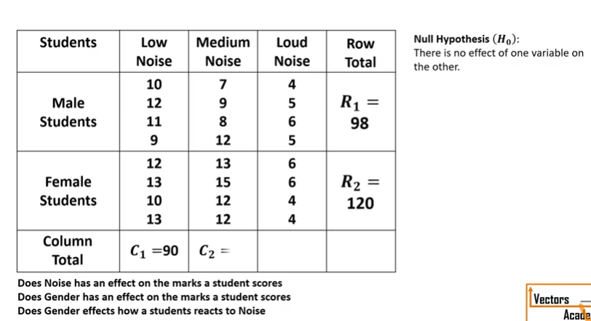
Example

Slide 29
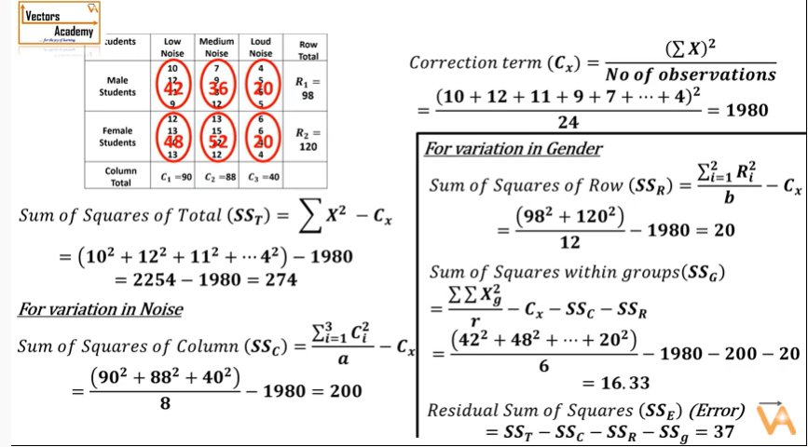
Example

Slide 30
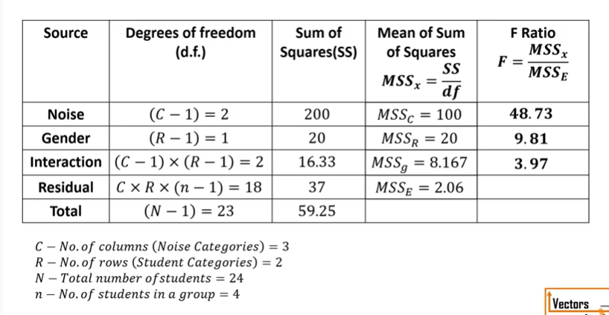
Example

Slide 31
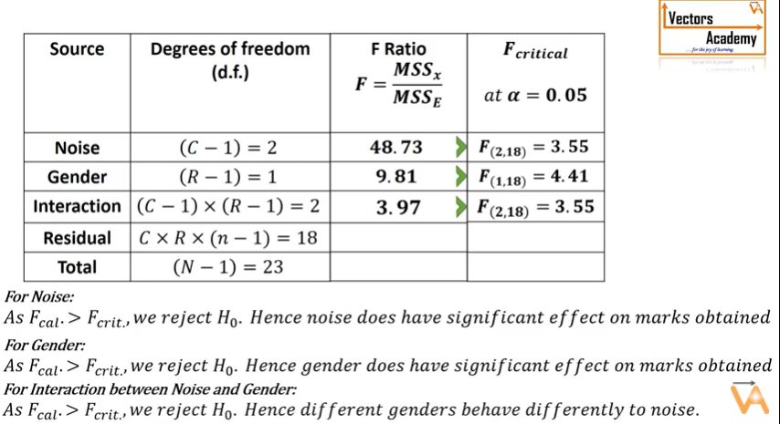
Example:

Slide 32
Two way anova with replication
Example 2 :set up anova table for the following information relating to the three drugs testing to judge the effectiveness in reducing blood pressure for three different groups of people
Drugs X Y Z
Group of people A | 14 15 | 10 9 | 11 11
B | 12 11 | 7 8 | 10 11
C | 10 11 | 11 11 | 8 7

Slide 33
Computation for two way anova with repeated values
Step (i) T = 187 , n = 18
Step (ii) correction factor = 187*187 /18
= 1942.72
Step(iii) SS between column (i.e between drugs)
= (73*73/6 + 56*56/6 + 58*58/6) - (187*187/18)
= 888.16 + 522.66 + 560.67 -1942.72
= 28.77

Slide 34
Step (iii) SS between rows (i.e between people)
= (70*70/6 + 59*59/6 + 58*58/6) – (187*187/18)
= 816.67 + 580.16 + 560.67 – 1942.72
= 14.78
Step(iv) total SS ={(14)² + (15)² + (12)² + (11)² +(10)² + (11)² +
(10)² + (9)² + (7)² + (8)² + (11)² + (11)² +
(11)² + (11)² + (10)² + (11)² + (8)² + (7)² – (187*187/18)
= 2019 -1942.72
= 76.28

Slide 35
Step (v) SS within samples
= (14-14.5)² + (15-14.5)²
+ (10-9.5)² + (9-9.5)² +
(11-11)² + (11-11)² + (12-11.5)² +(11-11.5)² +
(7-7.5)² + (8-7.5)² + (10 -10.5 )² + (11 – 10.5 )² +
( 10- 10.5)² + (11 -10.5 )² + (11 -11 ⁾² + (11- 11 )²
+ (8 – 7.5 )² + (7 – 7.5)² = 3.50
Step (vi) SS for interaction
= 76.28 - [28.77 + 14.78 + 3.50] = 29.23

Slide 36
Table :
The Anova Table
d.f. MS
Source of SS variation
F-ratio
5% F –
limit
Between column (i.e between drugs)
28.77
(3-1) = 2
28.77/2
= 14.385
14.385/ 0.389
= 36.9
F (2,9) = 4.26
Between rows (i.e between people)
14.78
(3-1) = 2
14.78 / 2
= 7.390
7.390/0.389
= 19.0
F (2,9) = 4.26
Interaction
29.23
4
29.23 / 4
= 7.308
7.308/0.389
= 18.786
F(4,9) = 3.63
Within sample errors.
3.50
(18- 9) = 9
Total
76.28
(18- 1)
= 17

Slide 37
The above table show that all the three f - ratio are significant of 5% level which means that
Conclusion
-the drugs act differently ,
-different groups of people are affected differently
-the interaction terms is significant

